Slide 1
Introduction to Uncertainty

Slide 2
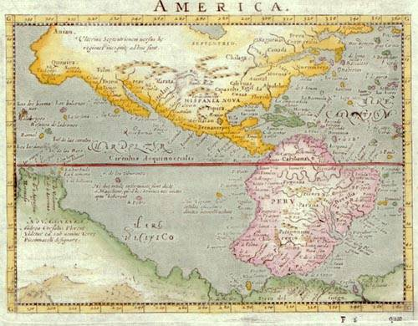

Slide 3
3 Sources of Uncertainty
Imperfect representations of the world
Imperfect observation of the world
Laziness, efficiency

Slide 4
First Source of Uncertainty: Imperfect Predictions
There are many more states of the real world than can be expressed in the representation language
So, any state represented in the language may correspond to many different states of the real world, which the agent can’t represent distinguishably
The language may lead to incorrect predictions about future states
On(A,B) ∧ On(B,Table) ∧ On(C,Table) ∧ Clear(A) ∧ Clear(C)
A
A
A
B
C
C
B
B
C

Slide 5
Observation of the Real World
Real
world
in some
state
Percepts
Interpretation of the percepts in the
representation language
On(A,B)
On(B,Table)
Handempty
Percepts can be user’s inputs, sensory data (e.g., image pixels), information received from other agents, ...

Slide 6

Second source of Uncertainty: Imperfect Observation of the World
Observation of the world can be:
Partial, e.g., a vision sensor can’t see through obstacles (lack of percepts)
R₁
R₂
The robot may not know whether there is dust in room R2

Slide 7
Second source of Uncertainty: Imperfect Observation of the World
Observation of the world can be:
Partial, e.g., a vision sensor can’t see through obstacles
Ambiguous, e.g., percepts have multiple possible interpretations
A
On(A,B) ∨ On(A,C)
B
C

Slide 8
Second source of Uncertainty: Imperfect Observation of the World
Observation of the world can be:
Partial, e.g., a vision sensor can’t see through obstacles
Ambiguous, e.g., percepts have multiple possible interpretations
Incorrect

Slide 9
Third Source of Uncertainty: Laziness, Efficiency
An action may have a long list of preconditions, e.g.: Drive-Car: P = Have-Keys ∧ ¬Empty-Gas-Tank ∧ Battery-Ok ∧ Ignition-Ok ∧ ¬Flat-Tires ∧ ¬Stolen-Car ...
The agent’s designer may ignore some preconditions ... or by laziness or for efficiency, may not want to include all of them in the action representation
The result is a representation that is either incorrect – executing the action may not have the described effects – or that describes several alternative effects

Slide 10
Representation of Uncertainty
Many models of uncertainty
We will consider two important models:
Non-deterministic model: Uncertainty is represented by a set of possible values, e.g., a set of possible worlds, a set of possible effects, ...
Probabilistic (stochastic) model: Uncertainty is represented by a probabilistic distribution over a set of possible values

Slide 11
Example: Belief State
In the presence of non-deterministic sensory uncertainty, an agent belief state represents all the states of the world that it thinks are possible at a given time or at a given stage of reasoning
In the probabilistic model of uncertainty, a probability is associated with each state to measure its likelihood to be the actual state
0.2
0.3
0.4
0.1

Slide 12
What do probabilities mean?
Probabilities have a natural frequency interpretation
The agent believes that if it was able to return many times to a situation where it has the same belief state, then the actual states in this situation would occur at a relative frequency defined by the probabilistic distribution
0.2
0.3
0.4
0.1
This state would occur 20% of the times

Slide 13
Example
Consider a world where a dentist agent D meets a new patient P
D is interested in only one thing: whether P has a cavity, which D models using the proposition Cavity
Before making any observation, D’s belief state is:
This means that D believes that a fraction p of patients have cavities
Cavity
¬ Cavity
p
1-p

Slide 14
Example
Probabilities summarize the amount of uncertainty (from our incomplete representations, ignorance, and laziness)
Cavity
¬ Cavity
p
1-p

Slide 15
Non-deterministic vs. Probabilistic
Non-deterministic uncertainty must always consider the worst case, no matter how low the probability
Reasoning with sets of possible worlds
“The patient may have a cavity, or may not”
Probabilistic uncertainty considers the average case outcome, so outcomes with very low probability should not affect decisions (as much)
Reasoning with distributions of possible worlds
“The patient has a cavity with probability p”

Slide 16
Non-Deterministic vs. Probabilistic
If the world is adversarial and the agent uses probabilistic methods, it is likely to fail consistently (unless the agent has a good idea of how the world thinks, see Texas Hold-em)
If the world is non-adversarial and failure must be absolutely avoided, then non-deterministic techniques are likely to be more efficient computationally
In other cases, probabilistic methods may be a better option, especially if there are several “goal” states providing different rewards and life does not end when one is reached

Slide 17
Other Approaches to Uncertainty
Fuzzy Logic
Truth value of continuous quantities interpolated from 0 to 1 (e.g., X is tall)
Problems with correlations
Dempster-Shafer theory
Bel(X) probability that observed evidence supports X
Bel(X) ≠ 1-Bel(¬X)
Optimal decision making not clear under D-S theory

Slide 18
Probabilities in detail

Slide 19
Probabilistic Belief
Consider a world where a dentist agent D meets with a new patient P
D is interested in only whether P has a cavity; so, a state is described with a single proposition – Cavity
Before observing P, D does not know if P has a cavity, but from years of practice, he believes Cavity with some probability p and ¬Cavity with probability 1-p
The proposition is now a boolean random variable and (Cavity, p) is a probabilistic belief

Slide 20
An Aside
The patient either has a cavity or does not, there is no uncertainty in the world. What gives?
Probabilities are assessed relative to the agent’s state of knowledge
Probability provides a way of summarizing the uncertainty that comes from ignorance or laziness
“Given all that I know, the patient has a cavity with probability p”
This assessment might be erroneous (given an infinite number of patients, the true fraction may be q ≠ p)
The assessment may change over time as new knowledge is acquired (e.g., by looking in the patient’s mouth)

Slide 21
Where do probabilities come from?
Frequencies observed in the past, e.g., by the agent, its designer, or others
Symmetries, e.g.:
If I roll a dice, each of the 6 outcomes has probability 1/6
Subjectivism, e.g.:
If I drive on Highway 37 at 75mph, I will get a speeding ticket with probability 0.6
Principle of indifference: If there is no knowledge to consider one possibility more probable than another, give them the same probability

Slide 22
Multivariate Belief State
We now represent the world of the dentist D using three propositions – Cavity, Toothache, and PCatch
D’s belief state consists of 2³ = 8 states each with some probability: {Cavity∧Toothache∧PCatch, ¬Cavity∧Toothache∧PCatch, Cavity∧¬Toothache∧PCatch,...}

Slide 23
The belief state is defined by the full joint probability of the propositions
State | P(state)
C, T, P | 0.108
C, T, ¬P | 0.012
C, ¬T, P | 0.072
C, ¬T, ¬P | 0.008
¬C, T, P | 0.016
¬C, T, ¬P | 0.064
¬C, ¬T, P | 0.144
¬C, ¬T, ¬P | 0.576
Probability table representation

Slide 24
Probabilistic Inference
State | P(state)
C, T, P | 0.108
C, T, ¬P | 0.012
C, ¬T, P | 0.072
C, ¬T, ¬P | 0.008
¬C, T, P | 0.016
¬C, T, ¬P | 0.064
¬C, ¬T, P | 0.144
¬C, ¬T, ¬P | 0.576
P(Cavity ∨Toothache) =
0.108 + 0.012 + ...
= 0.28

Slide 25
Probabilistic Inference
State | P(state)
C, T, P | 0.108
C, T, ¬P | 0.012
C, ¬T, P | 0.072
C, ¬T, ¬P | 0.008
¬C, T, P | 0.016
¬C, T, ¬P | 0.064
¬C, ¬T, P | 0.144
¬C, ¬T, ¬P | 0.576
P(Cavity) =
0.108 + 0.012 + ...
= 0.2

Slide 26
Probabilistic Inference
State | P(state)
C, T, P | 0.108
C, T, ¬P | 0.012
C, ¬T, P | 0.072
C, ¬T, ¬P | 0.008
¬C, T, P | 0.016
¬C, T, ¬P | 0.064
¬C, ¬T, P | 0.144
¬C, ¬T, ¬P | 0.576
Marginalization: P(C) = Σ_{t}Σ_{p} P(C∧t∧p) using the conventions that C = Cavity or ¬Cavity and that Σ_{t} is the sum over t = {Toothache, ¬Toothache}

Slide 27
Probabilistic Inference
State | P(state)
C, T, P | 0.108
C, T, ¬P | 0.012
C, ¬T, P | 0.072
C, ¬T, ¬P | 0.008
¬C, T, P | 0.016
¬C, T, ¬P | 0.064
¬C, ¬T, P | 0.144
¬C, ¬T, ¬P | 0.576
Marginalization: P(C) = Σ_{t}Σ_{p} P(C∧t∧p) using the conventions that C = Cavity or ¬Cavity and that Σ_{t} is the sum over t = {Toothache, ¬Toothache}

Slide 28
Probabilistic Inference
State | P(state)
C, T, P | 0.108
C, T, ¬P | 0.012
C, ¬T, P | 0.072
C, ¬T, ¬P | 0.008
¬C, T, P | 0.016
¬C, T, ¬P | 0.064
¬C, ¬T, P | 0.144
¬C, ¬T, ¬P | 0.576
P(¬Cavity∧PCatch) =
0.016 + 0.144
= 0.16

Slide 29
Probabilistic Inference
State | P(state)
C, T, P | 0.108
C, T, ¬P | 0.012
C, ¬T, P | 0.072
C, ¬T, ¬P | 0.008
¬C, T, P | 0.016
¬C, T, ¬P | 0.064
¬C, ¬T, P | 0.144
¬C, ¬T, ¬P | 0.576
Marginalization: P(C∧P) = Σ_{t} P(C∧t∧P) using the conventions that C = Cavity or ¬Cavity, P = PCatch or ¬PCatch and that Σ_{t} is the sum over t = {Toothache, ¬Toothache}

Slide 30
Possible Worlds Interpretation
A probability distribution associates a number to each possible world
If Ω is the set of possible worlds, and ω is a possible world, then a probability model P(ω) has
0 ≤ P(ω) ≤ 1
Σ_{ω∈Ω} P(ω)=1
Worlds may specify all past and future events

Slide 31
Events (Propositions)
Something possibly true of a world (e.g., the patient has a cavity, the die will roll a 6, etc.) expressed as a logical statement
Each event e is true in a subset of Ω
The probability of an event is defined as
P(e) = Σ_{ω∈Ω} P(ω) I[e is true in ω]
Where I[x] is the indicator function that is 1 if x is true and 0 otherwise

Slide 32
Komolgorov’s Probability Axioms
0 ≤ P(a) ≤ 1
P(true) = 1, P(false) = 0
P(a ∨ b) = P(a) + P(b) - P(a ∧ b)
Hold for all events a, b
Hence P(¬a) = 1-P(a)

Slide 33
Conditional Probability
P(a|b) is the posterior probability of a given knowledge that event b is true
“Given that I know b, what do I believe about a?”
P(a|b) = Σ_{ω∈Ω/b} P(ω) I[a is true in ω]
Where Ω/b is the set of worlds in which b is true
P(ω|b): A probability distribution over a restricted set of worlds!
If a new piece of information c arrives, the agent’s new belief (if it obeys the rules of probability) should be P(a|b∧c)

Slide 34
Conditional Probability
P(a∧b) = P(a|b) P(b) = P(b|a) P(a) P(a|b) is the posterior probability of a given knowledge of b
Axiomatic definition: P(a|b) = P(a∧b)/P(b)

Slide 35
Conditional Probability
P(a∧b) = P(a|b) P(b) = P(b|a) P(a)
P(a∧b∧c) = P(a|b∧c) P(b∧c) = P(a|b∧c) P(b|c) P(c)
P(Cavity) = Σ_{t}Σ_{p} P(Cavity∧t∧p) = Σ_{t}Σ_{p} P(Cavity|t∧p) P(t∧p)
= Σ_{t}Σ_{p} P(Cavity|t∧p) P(t|p) P(p)

Slide 36
Probabilistic Inference
State | P(state)
C, T, P | 0.108
C, T, ¬P | 0.012
C, ¬T, P | 0.072
C, ¬T, ¬P | 0.008
¬C, T, P | 0.016
¬C, T, ¬P | 0.064
¬C, ¬T, P | 0.144
¬C, ¬T, ¬P | 0.576
P(Cavity|Toothache) = P(Cavity∧Toothache)/P(Toothache) =
(0.108+0.012)/(0.108+0.012+0.016+0.064) = 0.6
Interpretation: After observing Toothache, the patient is no longer an “average” one, and the prior probability (0.2) of Cavity is no longer valid
P(Cavity|Toothache) is calculated by keeping the ratios of the probabilities of the 4 cases of Toothache unchanged, and normalizing their sum to 1

Slide 37
Independence
Two events a and b are independent if P(a ∧ b) = P(a) P(b) hence P(a|b) = P(a)
Knowing b doesn’t give you any information about a

Slide 38
Conditional Independence
Two events a and b are conditionally independent given c, if P(a ∧ b|c) = P(a|c) P(b|c) hence P(a|b,c) = P(a|c)
Once you know c, learning b doesn’t give you any information about a

Slide 39
Random Variables

Slide 40
Random Variables
In a possible world, a random variable X can take on one of a set of values Val(X)={x₁,…,x_{n}}
Such an event is written ‘X=x’
Capital: random variable
Lowercase: assignment of variable to value
Truth assignments to boolean random variables may also be expressed as ‘X’ or ‘¬X’

Slide 41
Notation with Random Variables
Capital letters A,B,C denote random variables
Each random variable X can take one of a set of possible values x∈Val(X)
Boolean random variable has Val(X)={True,False}
Although the most unambiguous way of writing a probabilistic belief is over an event…
P(X=x) = a number
P(X=x ∧ Y=y) = a number
…it is tedious to list a large number of statements that hold for multiple values x and y
Random variables allow using a shorthand notation (unfortunately a source of a lot of initial confusion!)

Slide 42
Decoding Probability Notation
Mental rule #1: Lowercase: assignments are often left implicit when unambiguous
P(a) = P(A=a) = a number

Slide 43
Decoding Probability Notation (Boolean variables)
P(X=True) is written P(X)
P(X=False) is written P(¬X)
[Since P(¬X) = 1-P(X), knowing P(X) is enough to specify the whole distribution over X=True or X=False]

Slide 44
Decoding Probability Notation
Mental rule #2: Drop the AND, use commas
P(a,b) = P(a∧b) = P(A=a ∧B=b) = a number

Slide 45
Decoding Probability Notation
Mental rule #3: Uppercase => values left implicit
Suppose Val(X) = {1,2,3}
When I write P(X), it states “the distribution defined over all of P(X=1), P(X=2), P(X=3)”
It is not a single number, but rather a set of numbers
P(X) = [A probability table]

Slide 46
Decoding Probability Notation
P(A,B) = [P(A=a ∧ B=b) for all combinations of a∈Val(A), b∈Val(B)]
A probability table with |Val(A)|x|Val(B)| entries

Slide 47
Decoding Probability Notation
Mental rule #3: Uppercase => values left implicit
So when you see f(A,B)=g(A,B) this means:
“f(a,b) = g(a,b) for all values of a∈Val(A) and b∈Val(B)”
f(A,B)=g(A) means:
“f(a,b) = g(a) for all values of a∈Val(A) and b∈Val(B)”
f(A,b)=g(A,b) means:
“f(a,b) = g(a,b) for all values of a∈Val(A)”
Order doesn’t matter. P(A,B) is equivalent to P(B,A)

Slide 48
Another Mnemonic: Functional Equalities
P(X) is treated as a function over a variable X
Operations and relations are on “function objects”
If you say f(x) = g(x) without a value of x, then you can infer f(x) = g(x) holds for all x
Likewise if you say f(x,y) = g(x) without stating a value of x or y, then you can infer f(x,y) = g(x) holds for all x,y

Slide 49
Quiz: What does this mean?
P(A∨B) = P(A)+P(B)- P(A∧B)
P(A=a ∨ B=b) = P(A=a) + P(B=b)
P(A=a ∧ B=b)
For all a∈Val(A) and b∈Val(B)

Slide 50
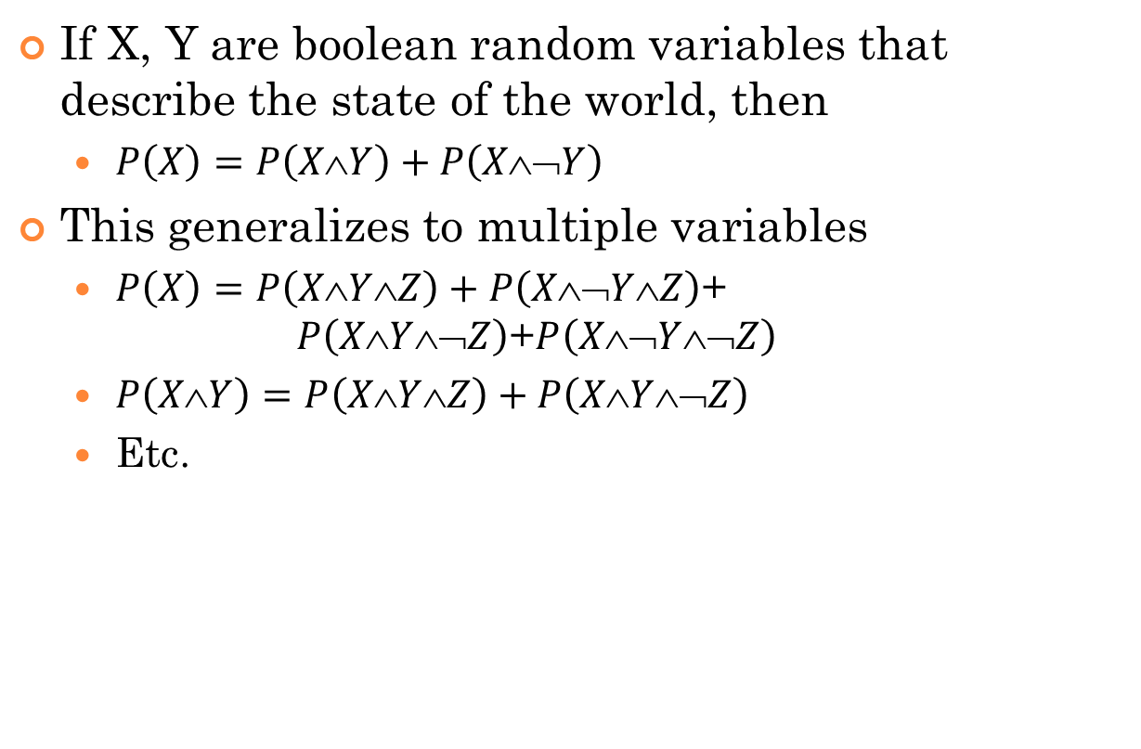
Marginalization
If X, Y are boolean random variables that describe the state of the world, then
$P\left(X\right)=P\left(X∧Y\right)+P\left(X∧\text{¬}Y\right)$
This generalizes to multiple variables
$P\left(X\right)=P\left(X∧Y∧Z\right)+P\left(X∧\text{¬}Y∧Z\right)$+ $P\left(X∧Y∧\text{¬}Z\right)$+$P\left(X∧\text{¬}Y∧\text{¬}Z\right)$
$P\left(XY\right)=P\left(XYZ\right)+P\left(XY\text{¬}Z\right)$
Etc.

Slide 51
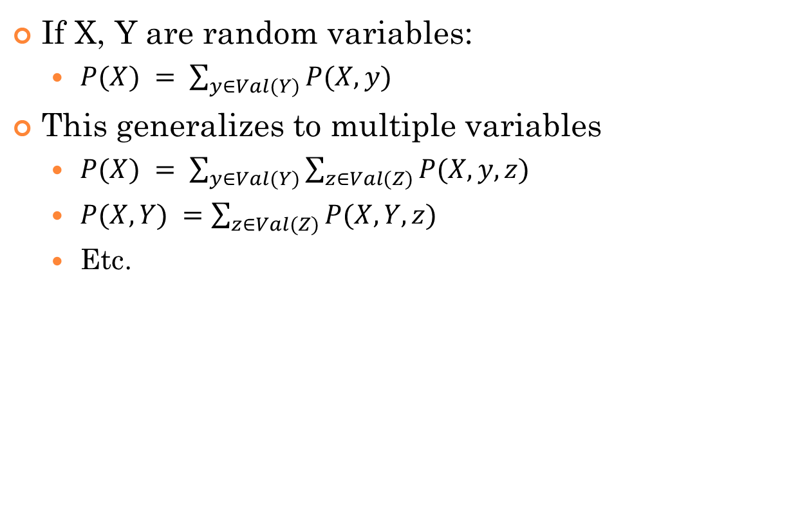
Marginalization
If X, Y are random variables:
$P(X) = \sum_{y∈Val(Y)}{P(X,y)}$
This generalizes to multiple variables
$P(X) = \sum_{y∈Val(Y)}{\sum_{z∈Val(Z)}{P(X,y,z)}}$
$P(X,Y) =\sum_{z∈Val(Z)}{P(X,Y,z)}$
Etc.

Slide 52
Decoding Probability Notation (Marginalization)
Mental rule #4: domains are usually implicit
Suppose a belief state P(X,Y,Z) is defined over X, Y, and Z
If I write P(X), I am implicitly marginalizing over Y and Z
P(X) = Σ_{y} Σ_{z} P(X,y,z)
P(X) = Σ_{y} Σ_{z} P(X ∧ Y=y ∧ Z=z)
P(X=x) = Σ_{y} Σ_{z} P(X=x ∧ Y=y ∧ Z=z) for all x
By convention, each of y and z are summed over Val(Y), Val(Z)
(should be interpreted as)
(should be interpreted as)

Slide 53
Conditional Probability for Random Variables
P(A|B) is the posterior probability of A given knowledge of B
“For each b∈Val(B): given that I know B=b, what would I believe is the distribution over A?”
If a new piece of information C arrives, the agent’s new belief (if it obeys the rules of probability) should be P(A|B,C)

Slide 54
Conditional Probability for Random Variables
P(A,B) = P(A|B) P(B) = P(B|A) P(A) P(A|B) is the posterior probability of A given knowledge of B
Axiomatic definition: P(A|B) = P(A,B)/P(B)

Slide 55
Conditional Probability
P(A,B) = P(A|B) P(B) = P(B|A) P(A)
P(A,B,C) = P(A|B,C) P(B,C) = P(A|B,C) P(B|C) P(C)
P(Cavity) = Σ_{t}Σ_{p} P(Cavity,t,p) = Σ_{t}Σ_{p} P(Cavity|t,p) P(t,p)
= Σ_{t}Σ_{p} P(Cavity|t,p) P(t|p) P(p)

Slide 56
Independence
Two random variables A and B are independent if P(A,B) = P(A) P(B) hence P(A|B) = P(A)
Knowing B doesn’t give you any information about A
[This equality has to hold for all combinations of values that A,B can take on]

Slide 57
Significance of independence
If A and B are independent, then P(A,B) = P(A) P(B)
=> The joint distribution over A and B can be defined as a product of the distribution of A and the distribution of B
Rather than storing a big probability table over all combinations of A and B, store two much smaller probability tables!
To compute P(A=a ∧ B=b), just look up P(A=a) and P(B=b) in the individual tables and multiply them together

Slide 58
Conditional Independence
Two random variables A and B are conditionally independent given C, if P(A ∧ B|C) = P(A|C) P(B|C) hence P(A|B,C) = P(A|C)
Once you know C, learning B doesn’t give you any information about A
[again, this has to hold for all combinations of values that A,B,C can take on]

Slide 59
Example of Conditional independence
Consider Rainy, Thunder, and RoadsSlippery
Ostensibly, thunder doesn’t have anything directly to do with slippery roads…
But they happen together more often when it rains, so they are not independent…
So it is reasonable to believe that Thunder and RoadsSlippery are conditionally independent given Rainy
So if I want to estimate whether or not I will hear thunder, I don’t need to think about the state of the roads, if I know that it’s raining

Slide 60
Next Class
Probabilistic inference
Exploiting conditional independence using Bayesian networks
Read R&N 13.1-5

